Slide 1
NET ZERO INDUSTRY
IMPACT INNOVATION Program

Slide 2

Net Zero Industry is one of the five programmes under Impact Innovation.

Slide 3
Net Zero Industry is one of five programmes within Impact Innovation, aiming to drive system-level change by engaging everyone who is directly or indirectly affected by the manufacturing industry in shaping the future.
Impact Innovation is Sweden’s major innovation initiative for addressing the challenges of our time through collaboration between industry, academia, and the public sector.
Impact Innovation is a joint initiative of the Swedish Energy Agency, Formas, and Vinnova. It is founded on the goals of Agenda 2030, the EU Missions, and broader societal policy objectives.

Slide 4
Impact Innovation
Broad and complex challenges
Long-term missions
A systems perspective that goes beyond technical solutions
Engagement of stakeholders across the entire ecosystem

Slide 5
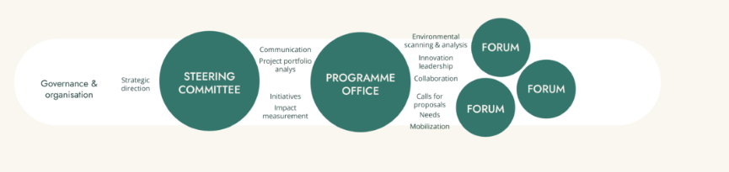
Organisation structure
Net Zero Industry’s organisation and activities are built on broad stakeholder collaboration. The programme office is operated by Teknikföretagen and https://www.ri.se/en, and is led by Pia Sandvik, CEO of Teknikföretagen. Experts, academic representatives, and strategic advisory groups contribute to the programme’s work. Activities are carried out in close collaboration with industry and the broader manufacturing ecosystem.

Slide 6

Net Zero Industry
Net Zero Industry is a 10-year programme with an annual budget of approximately SEK 150 million.
Its goal is to achieve a competitive and resilient Swedish manufacturing industry with net-zero greenhouse gas emissions by 2040.

Slide 7

Challenges
Industry contributes significantly to greenhouse gas emissions
Economic growth drives resource consumption
Industry is under pressure in an increasingly uncertain world

Slide 8

Role of the programme Office
Enabler and facilitator
Understanding the challenges and identifying critical leverage points
Addressing a range of key questions:
Where do the majority of greenhouse gas emissions from the manufacturing industry originate?
Which net-zero technologies are the most competitive?
How can the decoupling of resource use from economic growth be accelerated?
How can circularity contribute to increased competitiveness and resilience?
Which measures to reduce greenhouse gas emissions also strengthen resilience?

Slide 9
Programme Activities
Broad recurring calls aligned with the mission
Mission-strategic calls within priority areas (SMEs and skills development)
Project support to maximise project impact
Inspiration, mobilisation and networking
Methodological support and strategic development
International collaboration and connectivity
…
Knowledge-building initiatives

